Slide 1


BANGALORE INSTITUTE OF TECHNOLOGY
MAJOR PROJECT PHASE-II,REVIEW-I PRESENTATION
PI – NAS : Network Attached Storage
PRESENTED ON: 09/01/2026
PRESENTED BY:
NAME: Abhishek Agarwal
USN: 1BI22EC003
NAME: Aditya S Gowda
USN: 1BI22EC007
NAME: Aditya Umesh
USN: 1BI22EC008
NAME: Amruth Shirin KH
USN: 1BI22EC012
UNDER THE GUIDANCE OF:
PROF Likhitha K
ASSISTANT PROFESSOR
DEPT. OF ECE
DEPARTMENT OF ELECTRONICS AND COMMUNICATION ENGINEERING

Slide 2
BANGALORE INSTITUTE OF TECHNOLOGY
INSTITUTE VISION AND MISSION
Vision
To establish and develop the Institute as a center of higher learning, ever abreast with the expanding horizon of knowledge in the field of engineering and technology, with entrepreneurial thinking, leadership excellence for life-long success, and the ability to solve societal problems.
Mission
Provide high-quality education in the engineering disciplines from the undergraduate through doctoral levels with creative academic and professional programs. Develop the Institute as a leader in science, engineering, technology, and management, research, and apply knowledge for the benefit of society. Establish mutually beneficial partnerships with industry, alumni, local, state, and central governments by public service assistance and collaborative research. Inculcate personality development through sports, cultural, and extracurricular activities and engage in the social, economic, and professional challenges.
DEPARTMENT OF ELECTRONICS AND COMMUNICATION ENGINEERING

Slide 3
BANGALORE INSTITUTE OF TECHNOLOGY
DEPARTMENT VISION , MISSION, PEOs, PSOs
Vision
Imparting Quality Education to achieve Academic Excellence in Electronics and Communication Engineering for Global Competent Engineers.
Mission
Create state of art infrastructure for quality education.
Nurture innovative concepts and problem solving skills.
Delivering Professional Engineers to meet the societal needs.
PEOs
Prepare graduates to be professionals, practicing engineers, and entrepreneurs in the field of Electronics and Communication. Acquire sufficient knowledge for innovative techniques in the design and development of systems, and compete globally in multidisciplinary fields. Achieve personal and professional success with awareness and commitment to ethical and social responsibilities, both individually and as a team. Graduates will maintain and improve technical competence through continuous learning.
PSOs
PSO1: Core Engineering: The graduates will be able to apply the principles of Electronics and Communication in core areas.
PSO2: Soft Skills: An ability to use latest hardware and software tools in Electronics and Communication engineering.
PSO3: Successful Career: Preparing Graduates to satisfy industrial needs and pursue higher studies with social-awareness and universal moral values.
DEPARTMENT OF ELECTRONICS AND COMMUNICATION ENGINEERING

Slide 4
BANGALORE INSTITUTE OF TECHNOLOGY
CONTENTS
Abstract
Introduction
Literature Survey
Objectives
Methodology Adopted
Progress so far & Intermediate Results
Conclusion
Future Scope
References
DEPARTMENT OF ELECTRONICS AND COMMUNICATION ENGINEERING

Slide 5
BANGALORE INSTITUTE OF TECHNOLOGY
ABSTRACT
Data across multiple heterogeneous devices leads to fragmented storage, lack of redundancy, and higher chances of data corruption or loss.
Proposed System:
  A Raspberry Pi–based NAS using Gigabit Ethernet + USB 3.0 storage to deliver centralized network storage, remote access, and automated data handling.
Key Technical Features:
  5–8 W power consumption enabling continuous 24×7 operation
  Cost-optimized design (~₹10k–₹15k), cheaper than commercial NAS units
  SMB/NFS protocol support for multi-platform interoperability (Windows/Linux/Android/Smart TV)
  User-level authentication & permission-based access control for secure data management
DEPARTMENT OF ELECTRONICS AND COMMUNICATION ENGINEERING
Notes:
EXPECTED RESULTS

Slide 6
BANGALORE INSTITUTE OF TECHNOLOGY
INTRODUCTION
Managing personal data across multiple devices results in distributed storage, making data organization, backup, and security inefficient.
Network Attached Storage (NAS) provides a central repository for unified file access over IP-based networks.
Raspberry Pi acts as a low‑power microserver capable of running network storage protocols like SMB/NFS for seamless cross‑platform connectivity.
With USB 3.0 storage and Gigabit Ethernet, Raspberry Pi delivers optimized read/write throughput suitable for home and small‑office environments.
The system enables multi‑user authentication, controlled file‑permissions, and secure data access policies for different clients.
A Raspberry Pi NAS offers a cost‑efficient, scalable and 24×7 operational alternative to commercial NAS devices using open‑source software.
DEPARTMENT OF ELECTRONICS AND COMMUNICATION ENGINEERING
Notes:
EXPECTED RESULTS

Slide 7
BANGALORE INSTITUTE OF TECHNOLOGY
LITERATURE SURVEY
SL NO. | YEAR | AUTHOR | TITLE | METHODOLOGY
1. | 2024 | Dalal et al | Optimum Approaches for Building NAS Systems | Compares SBCs vs PC servers; evaluates NAS OS (OMV, FreeNAS); protocol & backup best‑practices. Justifies hardware + OS selection and enables VPN, RAID, remote access enhancements.
2. | 2024 | Malse et al. | Secure Private Cloud Storage System | Raspberry Pi + OpenMediaVault + CCTV + authentication; real‑time performance tested. Refines security, monitoring scripts & OMV‑based NAS deployment we can adopt.
DEPARTMENT OF ELECTRONICS AND COMMUNICATION ENGINEERING
Notes:
LITERATURE SURVEY

Slide 8
BANGALORE INSTITUTE OF TECHNOLOGY
LITERATURE SURVEY
SL NO. | YEAR | AUTHOR | TITLE | METHODOLOGY
3. | 2025 | Ghodake et al. | Network Attached Storage Using Raspberry Pi | Built Pi NAS with Samba/NFS + hybrid cloud backup (AWS/Nextcloud), compared speeds & cost. Supports our design choices, hybrid cloud backup included in future scope.
4. | 2025 | Gamess & Hester | Using a Raspberry Pi as a NAS | Performance tests of Raspberry Pi NAS with SMB/NFS + encryption benchmarking. Validates Pi 4/5 NAS performance, helps justify protocol selection and benchmarking in our work.
DEPARTMENT OF ELECTRONICS AND COMMUNICATION ENGINEERING
Notes:
LITERATURE SURVEY

Slide 9
BANGALORE INSTITUTE OF TECHNOLOGY
OBJECTIVES
Develop a cost‑efficient Raspberry Pi–based NAS with centralized storage.
Provide secure multi‑platform access using SMB/NFS protocols.
Improve network performance via USB 3.0 storage + Gigabit Ethernet.
Implement data protection using backup automation and monitoring.
Test multi‑user scalability and LAN transfer performance.
Ensure low‑power 24×7 operation and compare efficiency with commercial NAS.
DEPARTMENT OF ELECTRONICS AND COMMUNICATION ENGINEERING

Slide 10
BANGALORE INSTITUTE OF TECHNOLOGY
METHODOLOGY
Layered System Methodology (System Design Layers)
  Client Layer – React SPA
  • Secure UI for login & file operations
  • Communicates via HTTPS REST APIs
  Reverse Proxy Layer – Nginx/Caddy
  • SSL/TLS termination, rate limiting & caching
  • Secure routing to backend services
  Backend Service Layer – Node.js
  • Authentication with Email/Password + Google OAuth
  • JWT-secured APIs
  • Controllers for file/folder operations
  • Account + quota management with RBAC
  • Background job scheduler for data cleanup
DEPARTMENT OF ELECTRONICS AND COMMUNICATION ENGINEERING

Slide 11
BANGALORE INSTITUTE OF TECHNOLOGY
METHODOLOGY
Data & Storage Flow
  Database Layer – PostgreSQL + Prisma ORM
  • Users, files, folders, metadata, tokens & quota tracking
  • Optimized metadata I/O performance
  Storage Layer – Linux Filesystem + RAID1
  • Real file storage with redundancy
  • High-performance streaming upload/download
  • Soft delete + 30-day retention purge automation
  External Integration Layer – Google OAuth 2.0
  • Secure identity verification via token exchange
DEPARTMENT OF ELECTRONICS AND COMMUNICATION ENGINEERING

Slide 12
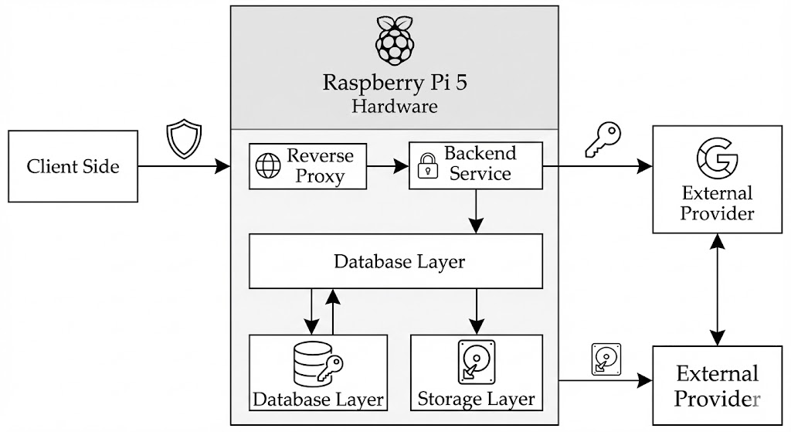
BANGALORE INSTITUTE OF TECHNOLOGY
METHODOLOGY
DEPARTMENT OF ELECTRONICS AND COMMUNICATION ENGINEERING

Slide 13
BANGALORE INSTITUTE OF TECHNOLOGY
RESULTS
Successfully deployed a secure, self-hosted cloud storage system on Raspberry Pi 5.
Achieved authenticated access with Email/Password, Google OAuth, and JWT security.
Delivered reliable file operations with metadata tracking and quota enforcement.
Implemented RAID1 storage for redundancy and data protection.
Ensured high performance and scalable architecture for future enhancements.
DEPARTMENT OF ELECTRONICS AND COMMUNICATION ENGINEERING

Slide 14
BANGALORE INSTITUTE OF TECHNOLOGY
CONCLUSION
Successfully developed a secure personal cloud storage system using Raspberry Pi.
Implemented RAID1 storage for data redundancy and protection against disk failure.
Provided authenticated and controlled access using Email/Password + Google OAuth.
Achieved efficient file upload, download, and metadata handling.
Ensured user privacy and complete ownership of stored data.
Designed a modular architecture allowing future feature expansion.
DEPARTMENT OF ELECTRONICS AND COMMUNICATION ENGINEERING

Slide 15
BANGALORE INSTITUTE OF TECHNOLOGY
FUTURE SCOPE
Implement file and folder sharing with access permissions.
Add file versioning and recovery history.
Enable remote access over the internet using secure tunneling / domain.
Integrate mobile apps for Android/iOS for seamless usage.
Introduce AI-based duplicate and large file detection for storage optimization.
DEPARTMENT OF ELECTRONICS AND COMMUNICATION ENGINEERING

Slide 16
BANGALORE INSTITUTE OF TECHNOLOGY
REFERENCES
Barrett, D., & Silverman, A. (2015). Raspberry Pi server essentials. Packt Publishing.
Bishop, M. (2019). Computer security: Art and science (2nd ed.). Addison‑Wesley.
Google Developers. (n.d.). Google Identity & OAuth 2.0 documentation. Retrieved December 5, 2025, from https://developers.google.com/identity
Linux Kernel Organization. (n.d.). Linux software RAID (mdadm) documentation. Retrieved December 5, 2025, from https://www.kernel.org/doc/
NGINX Inc. (n.d.). NGINX reverse proxy guide. Retrieved December 5, 2025, from https://nginx.org/en/docs/
DEPARTMENT OF ELECTRONICS AND COMMUNICATION ENGINEERING

Slide 17

BANGALORE INSTITUTE OF TECHNOLOGY
DEPARTMENT OF ELECTRONICS AND COMMUNICATION ENGINEERING

